Slide 1




HackOrbit 2025
TEAM SRM IST

Slide 2

THEME & PROBLEM STATEMENT
Healthcare Technology
MediSense AI – Smart Symptom-to-Action AI Health Assistant

Slide 3
PROPOSED SOLUTION
An AI-powered multilingual web application that analyzes user symptoms and recommends appropriate medical actions based on severity.
Integrates Gemini AI and online pharmacy search to provide diagnosis support, health education, and medicine purchase assistance.
A secure and modern authentication system with email OTP verification, OAuth (Google), JWT-based session handling, rate limiting (sliding window counter), and a complete forgot password flow.

Slide 4

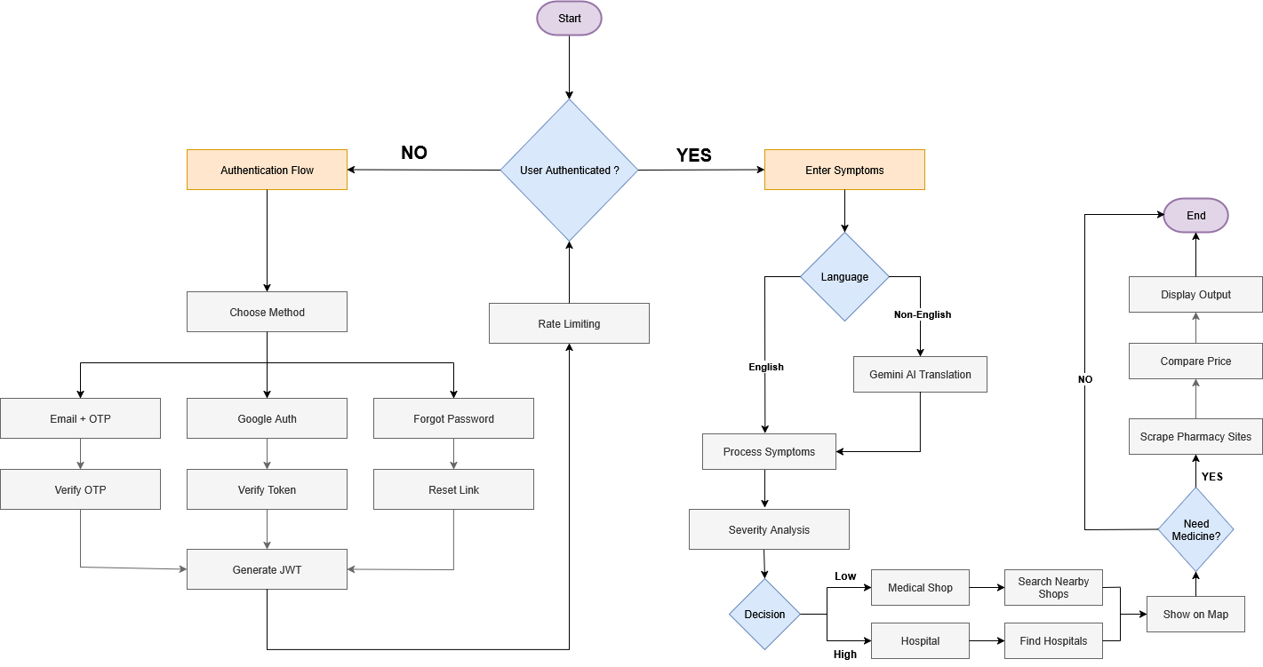
FLOWCHART / DIAGRAM

Slide 5
FLOWCHART / DIAGRAM
Explainer text
Users authenticate via Email OTP or OAuth, then input symptoms which are processed and translated if needed using Gemini AI.
Based on severity, the system suggests nearby medical shops or hospitals, and if needed, compares medicine prices from online pharmacies.

Slide 6
FEATURES AND NOVELTY
AI-powered symptom analysis
Smart medicine search
Multilingual chat interface
Privacy-first design
Novelty:
All-in-one AI assistant for diagnosis, education, and medicine — fast, simple, rural-friendly.

Slide 7
DRAWBACK AND SHOWSTOPPERS
Existing Systems: • Lack of multilingual support in symptom analysis • Generic suggestions without severity-based action • No integration with pharmacies or health education • Weak authentication and privacy protection
Proposed Solution: • AI output may vary with vague symptom inputs • Not a substitute for certified medical advice • Requires stable internet for full functionality • Multilingual NLP may misinterpret local phrases • Sensitive data risks if not securely handled

Slide 8
TEAM SRM IST
Anandhraj R (anandram221003@gmail.com) - 8610375292
Barath C T (barathctb@gmail.com) - 8778219462
Abhishek S (askabhishek079@gmail.com) - 8610535514

Slide 9
THANK YOU

